Slide 1

Diabetes Risk Prediction: IBM-AIML
Team Details:
J.S.S.ABHILASH (22101A010429)
C.KALYAN (22102A040722)
MAHAMMAD SIDDIQ (22101A010241)
U.SAI ROHITH (22101A010596)

Slide 2
AGENDA-REVIEW 1 (12.02.2024)
Abstract
Introduction
Problem Statement
Objectives
Literature Survey
Limitations of Existing System
Workflow of the Proposed System
References

Slide 3
ABSTRACT
The explosive population growth and health is an extremely crucial matter worldwide. Many harmful diseases are causing threats at high peak in recent years.
Introducing Machine learning techniques into healthcare for early prognosis and diagnosis need to be more accurate based on the parameters and phrases selected from the available clinical databases.
The objective of this project is to analyse, and explore various research outcomes of machine learning methods used in diabetes and how the efficiencies obtained could be helpful in future perspective of predictive diabetes model designing.

Slide 4
INTRODUCTION
Diabetes Mellitus is among critical diseases and many people are affected by this disease. Age, obesity, negligence, hereditary diabetes, living style, bad diet, high blood pressure, etc can cause Diabetes Mellitus. This diabetes Mellitus is also called simply as Diabetes. People who are affected by Diabetes they have high risk of getting affected by other health problems like Heart diseases, Kidney diseases, stroke, eye related problems and nerve damage, etc. Current practice in hospital is to collect required information for diabetes diagnosis through many tests and suitable treatment is provided based on result. In recent times, Big data Analytics plays an important role in healthcare Industries.
Types of Diabetes
There are mainly 3 types of Diabetes:
Type 1
Type 2
Gestational Diabetes

Slide 5
PROBLEM STATEMENT
Diabetes is a most common disease caused by a group of metabolic disorders. If a diabetes patient is untreated for a long time it causes an increase in blood sugar. machine learning algorithms and statistics are used to predict the stage of disease with the help of current and past data. we use logistic regression, random forest, and decision tree classifier.

Slide 6
OBJECTIVES
Early Detection:
Detecting the individuals by identifying the factors and symptoms, allows us to take preventive measures. Detection at the early stage of diabetes leads to better management and improved outcomes and helps in customizing the diet.
Healthcare Cost Reduction:
Detecting diabetes at an early stage can lead to cost decreases and decrease the complications in that stage. By focusing on prevention, resources can be saved.

Slide 7
LITERATURE SURVEY
S.No | Paper Title | Journal / Conference details | Methods Proposed | Datasets Used | Limitations
1. | Predictive analysis of diabetic patient data using machine learning and Hadoop | 2017 international conference on i-SMAC | 1.predictive analysis.machine leaning algorithm in Hadoop MapReduce environment | Pima Indaian Diabetes dataset | Data Quality and Completeness Bias and Fairness,Model Complexity and Interpretability
2. | predictive analytics in health care using machine learning tools and techniques | 2017 international conference on (ICICCS) | 1.predictive analysis 2.machine learning | healthcare,gov | Bias and fairnes,Temporal shifts and concept drift,Clinical adoption and inte5gration
3. | Predictive analytics in health care using machine learning tools and techniques | 2017 International Conference on I(ICICCS) | Predictive analysis and machine learning | MIMIC-III | Privacy and security,Generalization to diverse populations,Ethical considerations
4 | Classification and prediction of diabetes disease using machine learning paradigm Research Published: 03 January 2020 | Health information science and systems, 2020 | logistic regression . p value and odd ratio,decison tree,random forest | (NHANES) | Dataset limitations,sampling bias, feature set, external validations, temporal changes,clinical re;avance
Note: Specify links for datasets if available. Mention atleast 10 references. First reference should be your base paper. You can include more than 1 base paper as reference)

Slide 8
LITERATURE SURVEY
5 | Definition, Classification and Diagnosis of Diabetes, Prediabetes and Metabolic Syndrome | Canadian journal …, 2018 | Glycated hemoglobin ,Oral glucose tolerance test | (NHANES) | Lack of specificity , Lack of sensitivity , Lack of stability
6 | Application of data mining: Diabetes health care in young and old patients | Journal of King Saud University …, 2013 | Support vector machine algorithm | Non Communicable Diseases (NCD) | Regression-based data mining technique , Oracle Data Miner (ODM
7 | Prediction of diabetes based on personal lifestyle indicators | 2015 1st International Conference | Predictive analysis , Machine learning | pima indian diabetes | method, scope ,data
8 | Diabetes prediction using ensembling of different machine learning classifiers | 2021 healthcare conference | k-fold class validation multilayer perception | pima indian diabetes data set | limited labeled data, evalution metrics, public data set bias,climical validations
9 | Prediction of diabetes using artificial neural network approach | ICoEVCI 2018 | dataset selection,machine learning,daibetes prediction model | data samples of pima indains | limited features and details,model complexcity,temporal aspects
10 | Diabetes prediction using machine learning algorithms | Procedia Computer Science, 2019 | medical test,risk factor | Big Data Analytics | incomplete data,data quality issues,clinical validations

Slide 9
LIMITATIONS OF EXISTING SYSTEM
Every model has its own limitations, For this model also it has some limitations to point out.
Historical Data Limitations : Historical data plays a major role in Machine learning models. Historical data means past data. Especially machine learning models like diabetes risk prediction, heavily depends on past data.
But sometimes it may predict accurately present or future health trends.
Bias in Training Data: Here bias means error, If the training data used to develop the model is biased, then it gives incorrect results.
Because it cant make accurate predictions so, this fails overall model.
Challenges with Lifestyle: Even ML models also faces some complications in adapting to the changes in lifestyle. It includes changes like diet and exercise, where these factors are very crucial in diabetes risk.
This may affect the model’s ability to provide accurate long-term predictions.
Need for Regular Updates: Health patterns and risk factors may not be same for long period of time. They changes over time so, ML modes needs to be updated on regular basis regarding these factors to stay relevant and more efficient in predicting diabetes risk based on the most recent data.

Slide 10
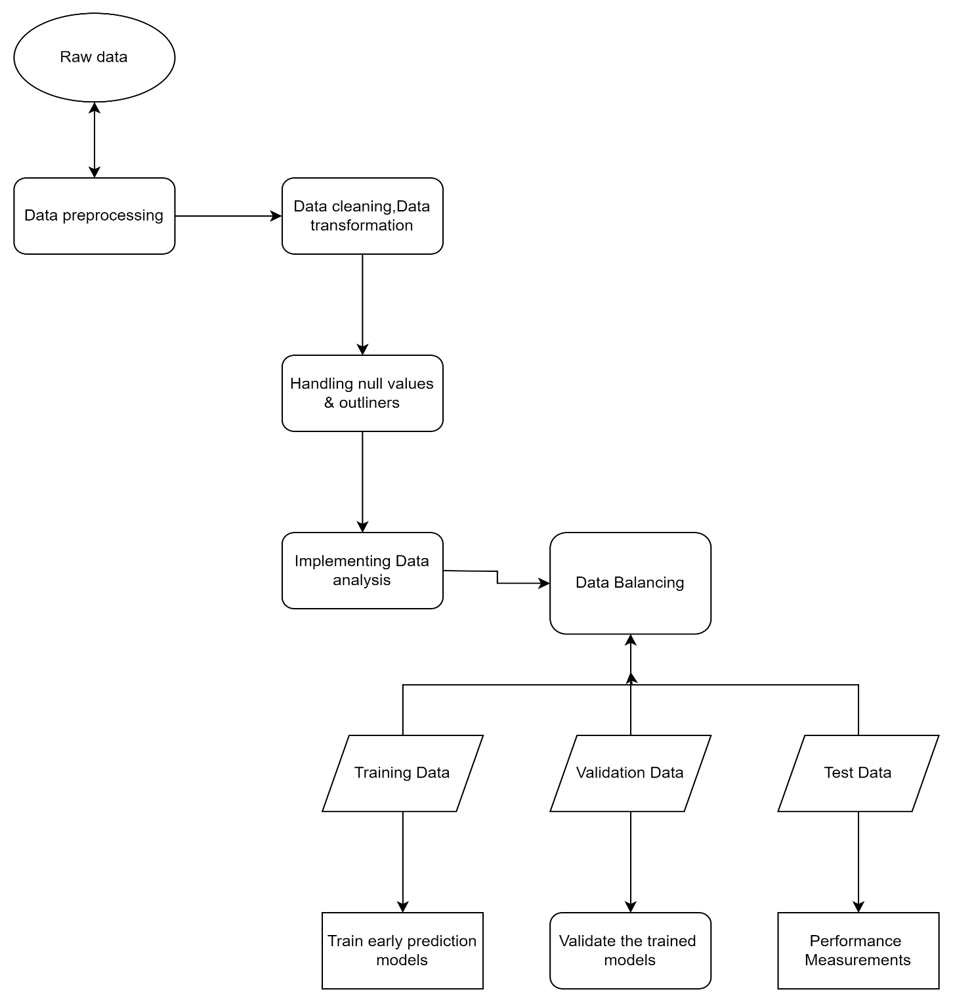
WORKFLOW OF PROPOSED SYSTEM

Slide 11
REFERENCES
Jaiswal, V., Negi, A., & Pal, T. (2021). A review on current advances in machine learning based diabetes prediction. Primary Care Diabetes, 15(3), 435-443.
Mujumdar, A., & Vaidehi, V. (2019). Diabetes prediction using machine learning algorithms. Procedia Computer Science, 165, 292-299.
Srivastava, S., Sharma, L., Sharma, V., Kumar, A., & Darbari, H. (2019). Prediction of diabetes using artificial neural network approach. In Engineering Vibration, Communication and Information Processing: ICoEVCI 2018, India (pp. 679-687). Springer Singapore.
Hasan, M. K., Alam, M. A., Das, D., Hossain, E., & Hasan, M. (2020). Diabetes prediction using ensembling of different machine learning classifiers. IEEE Access, 8, 76516-76531.
Liu, C., Zoph, B., Neumann, M., Shlens, J., Hua, W., Li, L. J., ... & Murphy, K. (2018). Progressive neural architecture search. In Proceedings of the European conference on computer vision (ECCV) (pp. 19-34).

Slide 12
REFERENCES
Bukhari, M. M., Alkhamees, B. F., Hussain, S., Gumaei, A., Assiri, A., & Ullah, S. S. (2021). An improved artificial neural network model for effective diabetes prediction. Complexity, 2021, 1-10.
Maniruzzaman, M., Rahman, M. J., Ahammed, B., & Abedin, M. M. (2020). Classification and prediction of diabetes disease using machine learning paradigm. Health information science and systems, 8, 1-14.
Kalyankar, G. D., Poojara, S. R., & Dharwadkar, N. V. (2017, February). Predictive analysis of diabetic patient data using machine learning and Hadoop. In 2017 international conference on I-SMAC (IoT in social, mobile, analytics and cloud)(I-SMAC) (pp. 619-624). IEEE.
Anand, A., & Shakti, D. (2015, September). Prediction of diabetes based on personal lifestyle indicators. In 2015 1st International Conference on Next Generation Computing Technologies (NGCT) (pp. 673-676). IEEE.
Eswari, T., Sampath, P., & Lavanya, S. J. P. C. S. (2015). Predictive methodology for diabetic data analysis in big data. Procedia Computer Science, 50, 203-208.

Slide 13


